Slide 1
Assistive technology
Early childhood
Hannah Norman and Katie Clift

Slide 2
What is assistive technology?
AT Device: Item, piece of equipment, or product system that is used to increase, maintain, or improve the functional capabilities of an individual with a disability
AT Service: Any service that directly assists an individual with a disability to select, acquire, or use an AT device, including physical, occupational, or speech therapy.
For young children, it needs to be play-based and appealing.

Slide 3
Why use it in early childhood?
Early childhood programs increase:
Physical, motor, cognitive, language, speech, socialization, and self-help skills
Early childhood programs decrease:
Chances of a student being placed in special education
The probability that children with disabilities will be socially dependent and institutionalized as adults

Slide 4
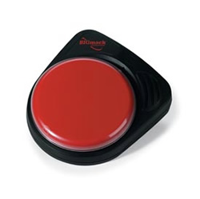
Single button communication device
Use: communication for nonverbal students
Teachers, parents, siblings, and friends can record important messages for nonverbal students to share in social settings.

Slide 5
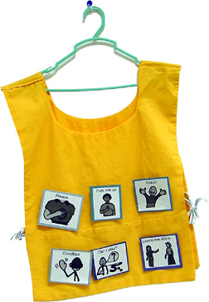
Communication smock
Use: communication for non-verbal students.
Students using nonverbal communication can point to the line-drawings to communicate wants and needs. The drawings are attached by Velcro and can be changed as needed.

Slide 6
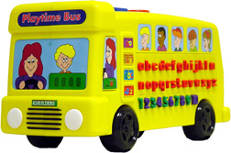
Playtime bus
Use: cognitive development
This bright yellow bus contains letter, shapes, and numbers for kids to touch and hear the names and sounds of each button

Slide 7
paintbrush
Use: cognitive and fine motor development.
This paintbrush is easy to grasp. This allows children who have difficulty with grasping access to art activities which build creative skills.

Slide 8
Other types of Assistive Technology
Low-tech
High-tech
Teacher made communication boards
Reading masks
Pencil holders
Adapted scissors
Electronic communication boards
Electronic books
Computers/Software
Touchscreens
Electric wheelchairs

Slide 9
Resources
http://www.edb.utexas.edu/ATLab/Labinventory/EarlyChildhood/ec-communicationaids.php
http://www.sheboyganfalls.k12.wi.us/csleynse/early-childhood-at-tools-and-resources/

