Slide 1
Low-Incidence Communication Devices (including Autism)
By: Brandie Gilliam

Slide 2
There are many ways a student will need Communication Devices…
Students will need to communicate their feelings to their teachers and classmates
Students will need to accommodate to the classroom settings (holding a pencil, having a schedule, pointing and picking objects for their work, and being able to participate in activities)
Students need help getting dressed
Students will need help when they are eating and/or drinking something

Slide 3
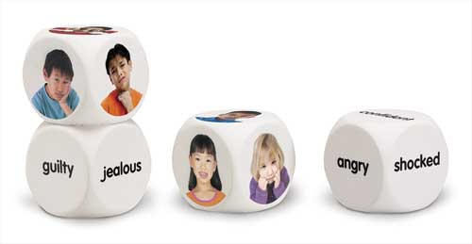
Emotional Cubes
Emotional Cubes are an excellent way for Low-Incidence students to be able to showcase their feelings, without having to do much. They are a set of cubes (like dice) that have a word, ex) angry and has a picture of a person that looks angry.
Students would be able to show their teachers how they might feel about something if they cannot use their words or body language.

Slide 4
Pencil Grips
There are several different kinds of pencil grips that Low-Incidence students could use for help with writing and drawing. Pencil grips are mainly used for helping students with fine motor disabilities, that may have problems holding a pencil steady.

Slide 5
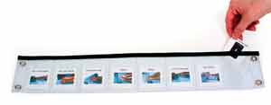
Schedule with Slip in Pockets (clear)
Students with Low-Incident disabilities who may be able to use their motor skills but not as good as others, can use this schedule with slip in pockets that are clear and will be able to keep up with everyone else who may write their schedule down. It is not as easy as a velcro schedule so they will still have a challenge to be able to put their schedule sheets into the slip in pockets.

Slide 6
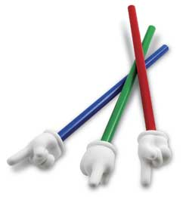
Hand Pointers
Hand pointers are very useful for students that have Low-Incident disabilities. Many students could be physically unable to reach for something, or to point at an object, and this is where a hand pointer would be very reliable to the student. The student would then be able to show teachers what they want, or the correct answer to a activity in the classroom.

Slide 7
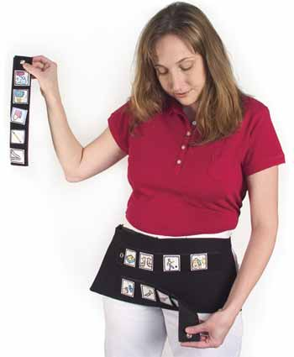
Picture Slides
Students will be able to participate in classroom activities with their peers if they are able to communicate through symbols and pictures. By students having a picture slide they will be able to communicate with others easily. A picture slide may consist of slides that have a word like NO on it and then has a picture of a X to communicate to others.

Slide 8
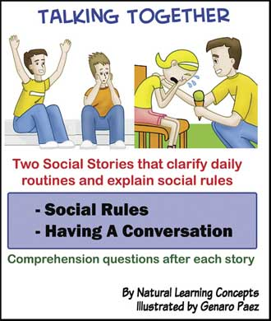
Participating in Activities with Classmates
There is a set of books that is called “Talking Together.” These books will be able to help students with communication problems (especially Autism) learn to talk to others and by them learning to communicate they will then be able to participate in activities with their classmates.

Slide 9
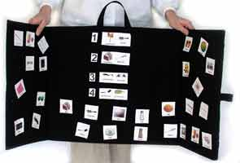
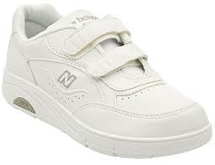
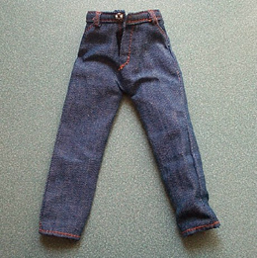
Getting Dressed
Many students will need help getting dressed in the morning every day. If could be that they might need a picture set of going through the motions, or to the extent of using velcro, button snaps and/or other substances to accommodate them better than tying their shoes or buttoning their shirts and/or pants.

Slide 10
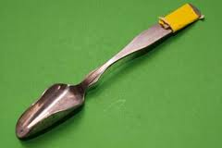
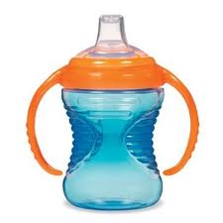
Eating and/or Drinking
Low-Incident students may need help with eating and/or drinking at breakfast, lunch, snack time, and dinner. There are several ways of helping students accommodate to be able to individually feed themselves and/or be able to hold a drink. Students could use a style cup like a “sippy cup.” Students could use modified forks and spoons, and many caregivers/teachers will have to cut up their food and let them just pick it up to eat.

Slide 11
Resource Used
AR
(Augmentative Resources)
http://www.augresources.com/vindex.html

