Slide 1
RJ Cooper :Changing the World With One Adaptation At a Time
By Amanda Gibson

Slide 2
RJ Cooper
RJ Cooper has a background in electrical engineering and developmental psychology and a strong motivation to do good, he explains,
“I was either going to join the Peace Corp or find or create something to use my computer talents to help people.” – RJ cooper
“I knew nothing, I don’t think I had actually even met a person with a disability at that point (When he went to work at University of Utah rehabilitation center). But I could program, make colors flash on a computer… Little did I know they would heap the world right on me that very week! I became an established fixture in the department, and even had doctors and medical interns watching me work with a coma patient.”- RJ Cooper
http://www.nationaltechcenter.org/index.php/2009/11/12/ipro-beyond-switches/

Slide 3
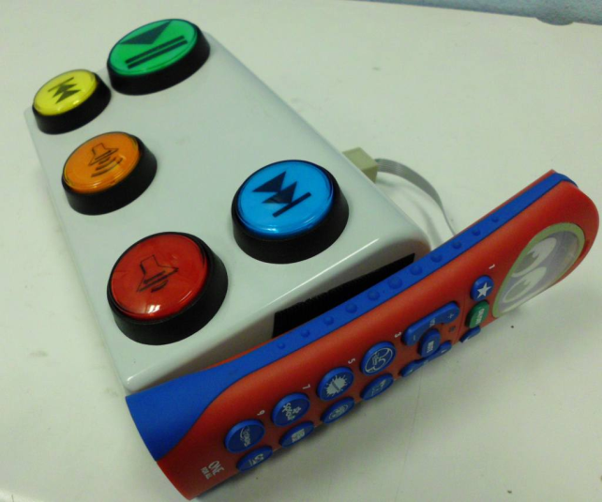
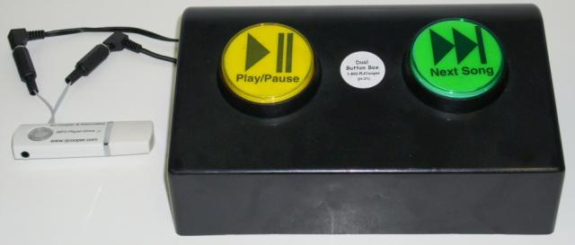
Switch- Adapted Gadgets
Have anywhere from 1 to 5 buttons that help the disabled person use their electronics.
The device on the left is a switch-adapted gadget for a television remote. This allows the student to push a button to turn the television on, off, change channel, and make volume go up or down. The device on the right is a MP3 player and it has two buttons on it so the listener can play,
or pause it or go to the next song.

Slide 4
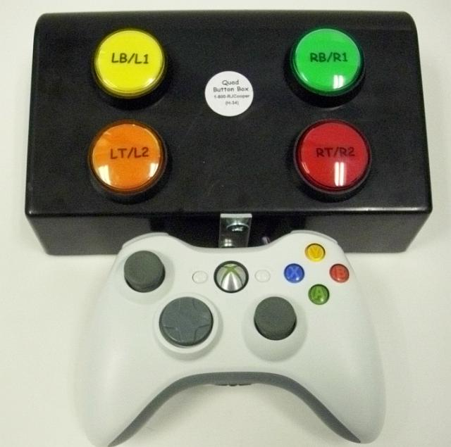
Video Game Adaptation
Sometimes teachers might want to use a videogame to teach a student, or if a parent asks if there are any ways that their children can play video games, RJ cooper has made an adaptation to a few of the game consoles’ controllers.
This to the right is the xbox 360 controller,
and it is the adaptation for the buttons on
the back, which are usually very small.
http://www.rjcooper.com/

Slide 5
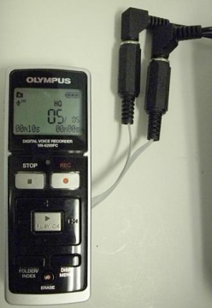
Voice recorder
“A mom emailed me, asked me to research a way for her college-bound, and physically challenged son to be able to record lectures.
So here it is. I'm currently using the model specified under the picture above here. At Standard Play, it can record about 70 hours of lecture (at Long Play, which is just fine also, over 400 hours!). It records in the Windows standard WMA (Windows Media Audio). Using the included USB cable, it acts as a 'hard drive' to your PC or Mac (512 MB flash drive). The WMA files play back right from Windows in iTunes or any song-playing software (can play on Mac with special software also).
I've adapted the Play and Record buttons. The unit powers down after 5 minutes of non-use. Either switch wakes it up. The next Record switch press starts recording. It records sequentially without having to do any folder setting up. It's very easy. You stop recording with either switch. For note-taking, you stop/start as many times as they want.”

Slide 6
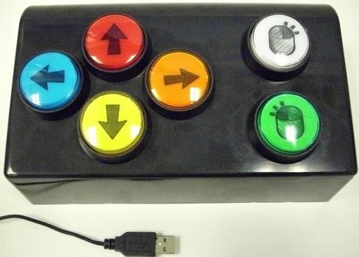
Mouse Adaptation
Once in awhile I come across someone that can use their hand(s) to some extent, but not well. But they want to use their hand(s). My SAM-Joystick is a great choice but is big and a bit pricey, and for some, it's just difficult. So I invented this Mouse Button-Box. Not too much needs explaining here. It's USB so it works on both Mac and Windows (requires accompanying software for both). Very adjustable speeds and functions, even a dwell-click (Windows).

Slide 7
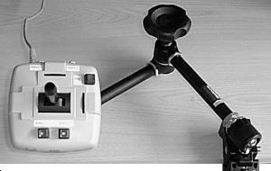
Magic Arm
This device holds things in place, so that
The person can use it. The picture on the
Right is holding a joystick in place. This arm is infinitely adjustable, and stays where you put it. This can be used to hold cameras, joysticks, and many other things.

Slide 8
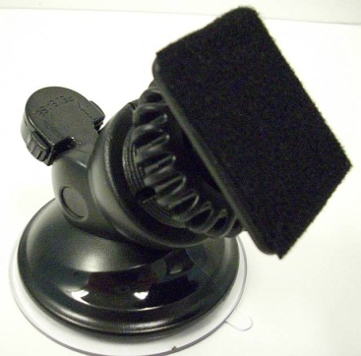
Switch Positioner
I'm a big fan of putting any hand-operated switch on an angle. I don't like placing them flat, either on a laptray or a table, because the user might just lay on the switch, or have a tough time getting *off* the switch, once on. The only times I like placing switches flat are: If the user has had a lot of experience and is successful at getting on/off (especially off) the switch
If the user needs to 'creep' up to the switch, using the surface as a support (I have never seen this situation, but it probably exists)

Slide 9
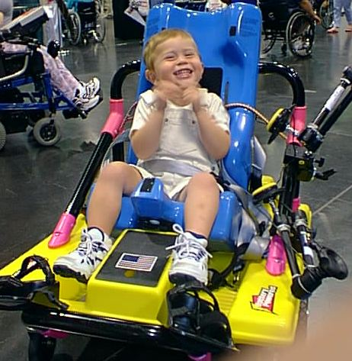
Cooper Car
The “car” or chair is operable by 1-4 switches, 1 for each direction, or a joystick. I usually use 1-2 switches, since a direction switch causes the vehicle to spin on its access, so if you have a second switch plugged into the Left jack, and wish to turn right, just spin 270 degrees.
The CooperCar only works for kids less than 50 pounds.

Slide 10
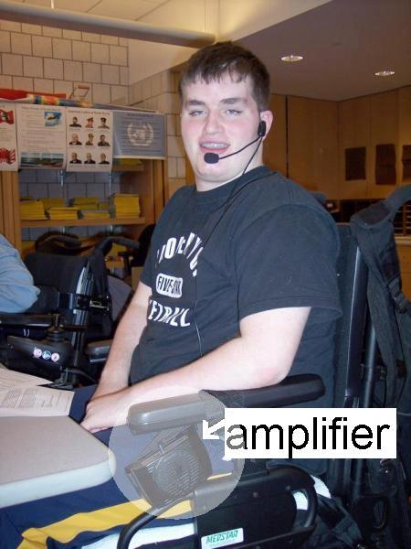
Voice Amplifier
Several times in assessing learners for AAC devices, I have come across people that have very low volume, but they can talk (like Brian). Let me assure you, as I do the caregivers of such people: Nothing, I repeat, nothing will be as efficient and usable as their natural voice. We just need to get it louder!
Brian from NY

Slide 11
Resources
http://www.rjcooper.com/
http://www.nationaltechcenter.org/index.php/2009/11/12/ipro-beyond-switches/

